Slide 1
NDOW
Urban Wildlife
Urban Wildlife: Wildlife that can live or thrive in urban environments. Some urban wildlife, such as mice, rats and birds are synanthropic, ecologically associated with humans. Different types of urban areas support different kinds of wildlife.
Synanthropic : a member of a species of wild animal and/or plant of various kinds that live near, and benefit from, an association with humans and the somewhat artificial habitats that humans create around them. Those habitats include houses, gardens, farms, roadsides, garbage dumps, and so on.

Slide 2
NDOW
Urban Wildlife
Three regions (Western, Eastern and Southern)
  We work somewhat independently on Urban Wildlife issues due to the divers needs across the state.
  Seasonal variation in call and response volumes.
  Populations
  Wildlife

Slide 3
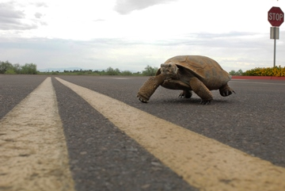
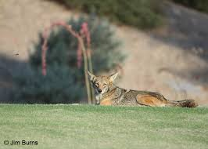
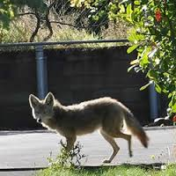
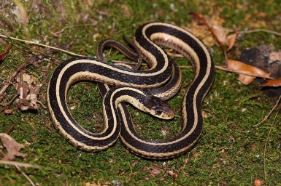
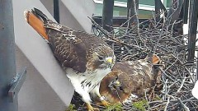
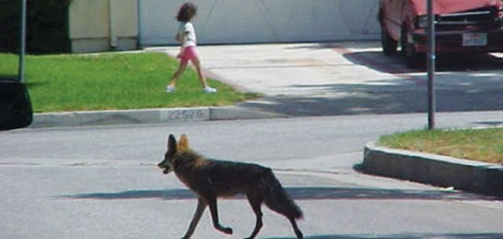
Southern Region
Las Vegas, Pioche, Henderson, Tonopah
Issues
Waterfowl/aquatic birds
  injured at urban parks
  Tangled in fishing line
Burrowing owls
  displaced by urban development
Owls and raptors
  injured or young fall out of nests
Snakes of various species on people’s property
  Usually non-venomous species that we try to educate the public about.
Desert tortoise
  Tricky confirming whether an individual is an escaped “pet”, or a wild tortoise displaced by development or Wild.
Woodpeckers with a knack for drilling into stucco
Coyote calls

Slide 4
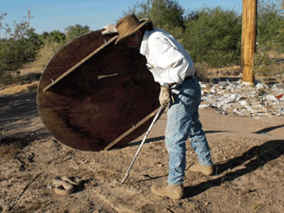
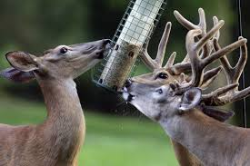
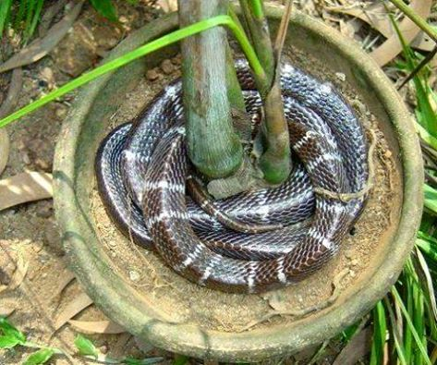
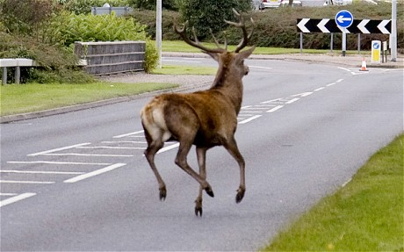
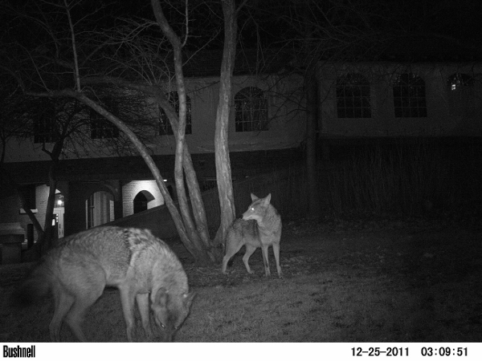
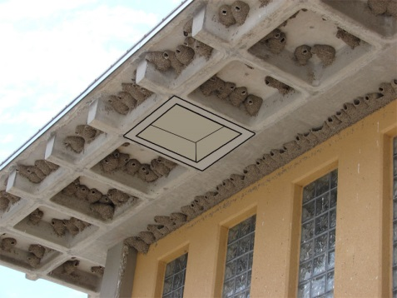
Eastern Region
Elko, Ely, Eureka, Battle Mountain
Owls and Raptors
  Nesting
  Dive-bombing dogs
  Eating birds at the feeders
  Injured
Small birds
  Nesting in bushes
  ID them
Snakes / reptiles
  In buildings
  In yard-planters, garden, dog house
Small mammals (mice, rabbits, squirrels, Bats)
  Eating gardens
  Making messes in the yard
  To many of them around the house

Slide 5
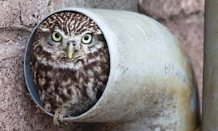
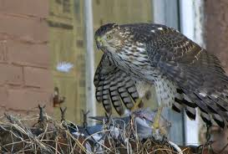
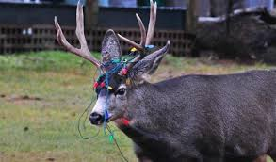
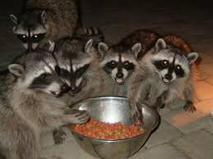
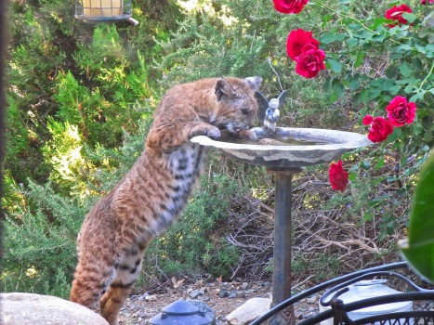
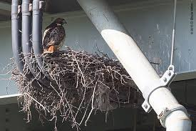
Western Region
Reno, Carson City, Winnemucca, Fallon, Yerington
Owls and Raptors
  Nesting
  Dive-bombing dogs
  Eating birds at the feeders
  Injured
Birds / woodpeckers
  Nesting
  Injured
  Burrowing into the house stucco
Snakes / reptiles
  In buildings
  In yard-planters, garden, dog house
Small mammals (mice, rabbits, squirrels, bats)
  Eating gardens
  Making messes in the yard
  To many of them around the house
Medium & Large mammals
  Coyote, deer, bobcat, raccoon

Slide 6
Western Region calls
July and August
Top 5
Hawks & Owls
Coyote
Birds
Deer
Small & Medium mammals
818 Calls
360 hours spend on calls in the Western region.
Of these call 22 needed to have physical responses equaling roughly 500 miles and 60 hours.

Slide 7
New positions
Reno Las Vegas
Reno & Las Vegas Position
Primary duties
  Answer urban wildlife calls.
  Educate the public on living with wildlife.
  Respond were needed to urban wildlife calls posing a public safety concern.
    These responses will be limited (injured hawks, venomous snakes.)

